Slide 1
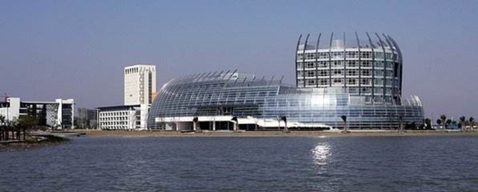
Maximum Channel Access Probability Based on Post-Disaster Ground Terminal Distribution Density
Xingxing Hu
Donghua University, Shanghai, China
2181295@mail.dhu.edu.cn
Notes:
Hello, everyone. It's my pleasant duty to report my research. Today I'd like to say something about a novel path planning approach, which topic is ……

Slide 2
CONTENTS
Background
Problem & challenge
Contributions
System Model
Problem formulation & analysis
Simulation analysis
Conclusion
2
Notes:
I will introduce my thesis from these aspects.

Slide 3
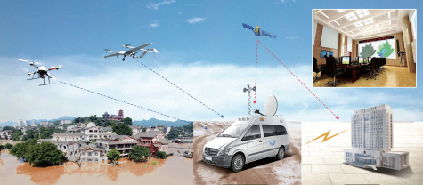
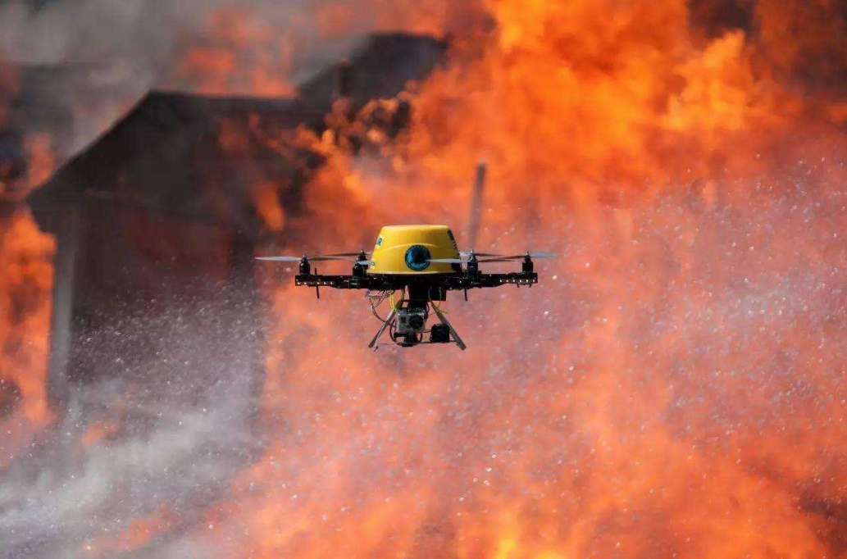
Background
After the disaster, the ground communication infrastructure will be severely damaged, which will bring great troubles to rescue work.
Due to its lightness, compactness, flexible layout and high probability of line-of-sight transmission, UAVs have been widely used in post-disaster rescue work.
Aerial BS, relay, information dissemination and data collection.
3
Notes:
From this picture we can see, the rapid development of society has gradually increased the number of vehicles on the road, but many remote suburbs and some urban roads have not deployed RSU, and road information cannot be exchanged in real time. Which will cause …..
But the energy of UAV is limited.
Time for unmanned aerial vehicle (UAV) assisted vehicular ad hoc networks(VANETs) to promote the efficient data transmission is limited. To this end, improving the endurance of UAV has become a crucial issue.

Slide 4
Problem & Challenge
The impact levels in the whole post-disaster area maybe different. We should use a suitable distribution to model the location of ground terminal (GT) according to GTs’ distribution densities.
UAV’s speed should be adjusted according to GTs’ s distribution densities.
A dynamic channel resource schedule should be made to further improve channel access probability.
4

Slide 5
Contributions
A more suitable Thomas cluster process (TCP) rather than Poisson point process (PPP) is used to model the locations of GTs and each cluster has different GT distribution density.
We propose an UAV adaptive speed cruise model based on GT distribution density among the whole disaster area.
An efficient channel schedule method is proposed to alleviate resource competition.
5

Slide 6
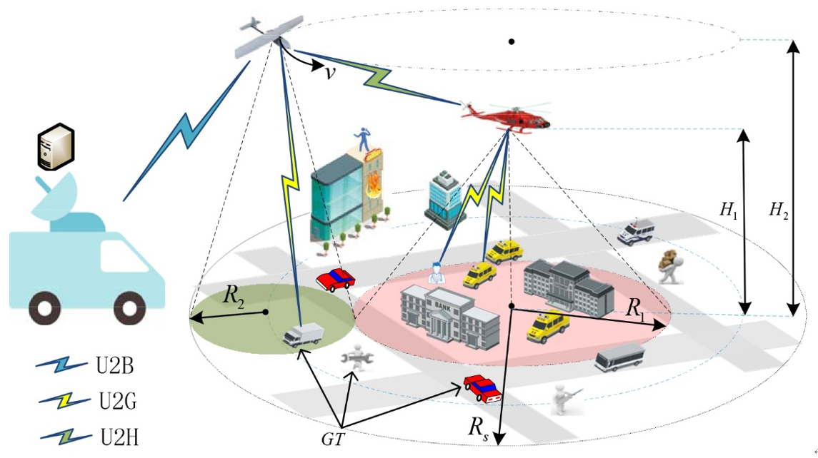
System Model -- Network Structure
A hover flying helicopter (HFH) is deployed to cover the worst heavily hit area. The cruise flying UAV circles around HFH. The coverage of HFH and UAV is neither overlap nor gap
The coverage radius of HFH and UAV are
and the corresponding flying heights are
There are many GTs in the ground of post-disaster area and all GTs are equipped with battery powered transceivers. GTs located in different area could communicate with corresponding aircrafts.
6
Notes:
As shown in picture, in the front and rear ends of the road deployed road side unit (RSU) that collect information on road traffic conditions.
a section of RSU that is not covered is divided into a series of subsegments, and each road section is provided with a UAV to provide network services.

Slide 7
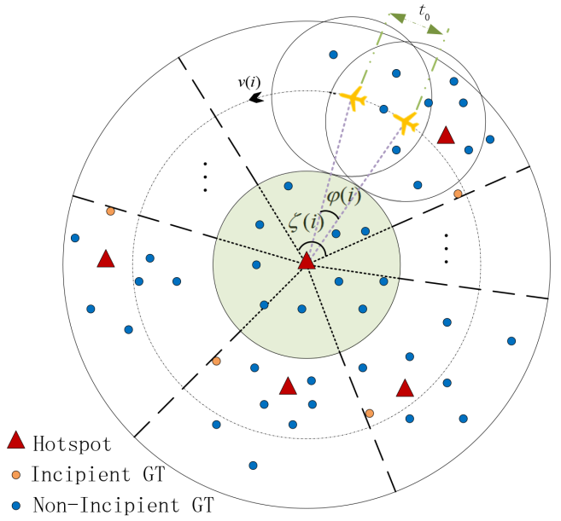
System Model -- GT Distribution
The locations of hotspots, such as densely populated areas, are modeled by an independent PPP .
The locations of all GTs who are scattered around hotspots are modeled by TCP.
When UAV flies over subregion , the speed of UAV is .
7
Notes:
As shown in picture, in the front and rear ends of the road deployed road side unit (RSU) that collect information on road traffic conditions.
a section of RSU that is not covered is divided into a series of subsegments, and each road section is provided with a UAV to provide network services.

Slide 8
System Model -- Channel Model
We consider the Air-to-Ground channel which is dominated by Light-of-Sight link:
Channel power gain
Small scale fading
Distance from GT to the horizontal projection point of its corresponding aircraft
Flying height of HFH or UAV
8
Notes:
On the one hand, energy consumed by the UAV to maintain flight and attitude propulsion, on the other hand, communication energy which used to communicate with sensor nodes on the ground, such as vehicle, base station and so on .

Slide 9
System Model -- Cruise Model
We introduce the channel access delay (seconds) which indicates the minimum time for establishing a complete communication link with the UAV is .
UAV will adjust its speed according to the GT distribution density among the whole post-disaster area. So, UAV has different optimal speed when flying through different subregion.
The UAV is fixed-wing and it needs a minimum speed to maintain its aloft.

Slide 10
Problem formulation
Channel SNR threshold probability:
It is defined as the probability that a random GT satisfies the SNR condition when it picks up the detection signal sent by its corresponding aircraft.
Aircraft’s transmission power
SNR threshold
Noise power

Slide 11
Problem formulation
Channel schedule :
It denotes the percentage of channels obtained by HFH when the UAV flies over subregion
Average number of GTs under HFH coverage area
GT distribution density of cluster
Overlapping area within when UAV flies over the sector ring

Slide 12
Problem formulation
Cruise efficiency:
Maximum cruise cycle
The required time that UAV flies past subregion
Notes:
Note that the constraint is a non-convex constraint, therefore, the problem is hard to solved. The image of the objective function resembles a check mark function.

Slide 13
Problem formulation
Channel access probability of subregion :
Probability that any GT under UAV coverage can connect to UAV
Probability that any GT under HFH coverage can connect to HFH
Notes:
Note that the constraint is a non-convex constraint, therefore, the problem is hard to solved. The image of the objective function resembles a check mark function.

Slide 14
Problem formulation
Objective function:
Our goal is to obtain the maximum channel access probability by optimizing the flight speed of UAV.
Notes:
Note that the constraint is a non-convex constraint, therefore, the problem is hard to solved. The image of the objective function resembles a check mark function.

Slide 15
Problem analysis
It is easy to prove that the constraints are all convex.
Through scaling and Taylor expansion, we can prove that the objective function is also convex.
By using the standard convex optimization algorithm, we can get the optimal solution to the problem.
Notes:
Note that the constraint is a non-convex constraint, therefore, the problem is hard to solved. The image of the objective function resembles a check mark function.

Slide 16
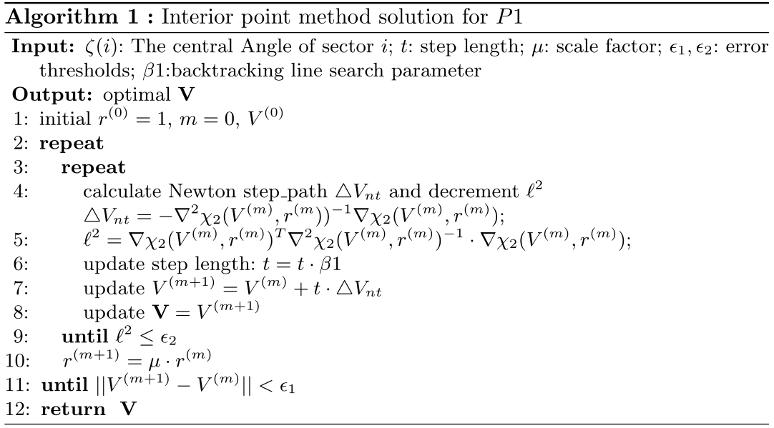
Interior point method

Slide 17
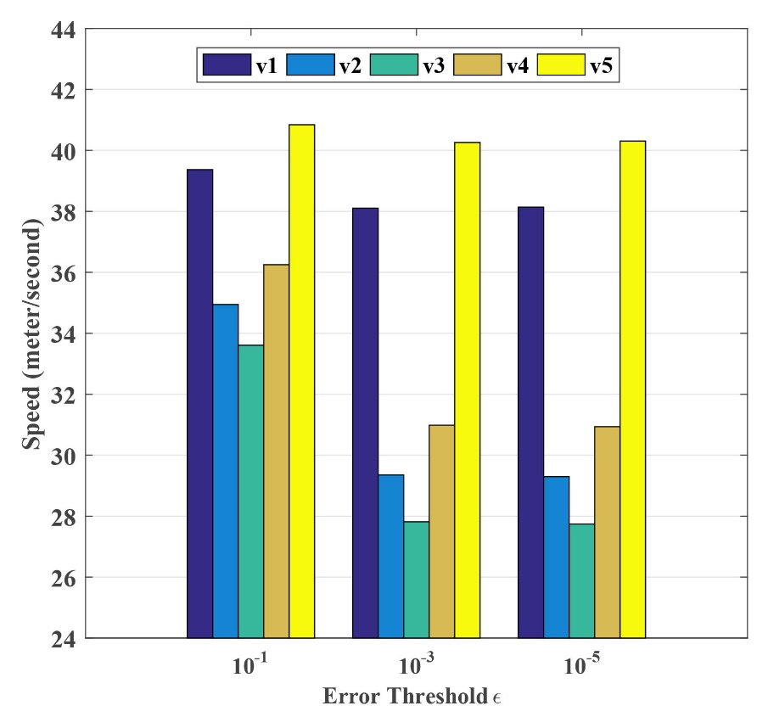
Simulation analysis
The optimal speed of the drone under different errors
17
Notes:
We found that the energy consumption under the optimized algorithm is more energy-efficient than the optimized algorithm in this picture , the optimized algorithm improves the endurance of the UAV when the distance between the UAV and the cluster head vehicle is increased. And the threshold value of receive power set by the vehicle is not changed, the energy consumption is also increased as the altitude is increased. We further found that this effect is greater with increasing.
altitude

Slide 18
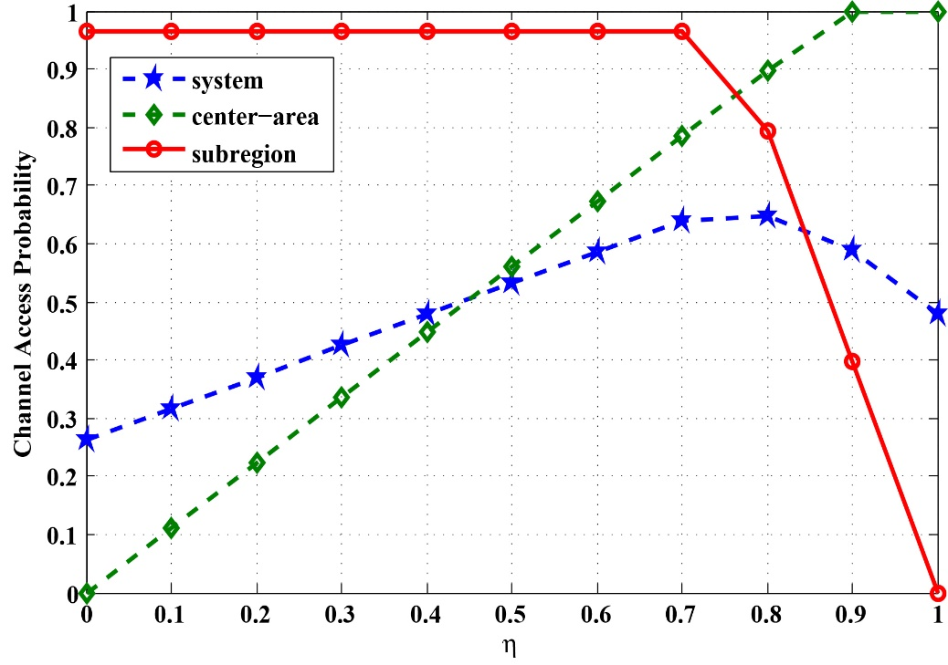
Simulation analysis
Comparison of system channel access probability under different channel schedule
18
Notes:
We found that the energy consumption under the optimized algorithm is more energy-efficient than the optimized algorithm in this picture , the optimized algorithm improves the endurance of the UAV when the distance between the UAV and the cluster head vehicle is increased. And the threshold value of receive power set by the vehicle is not changed, the energy consumption is also increased as the altitude is increased. We further found that this effect is greater with increasing.
altitude

Slide 19
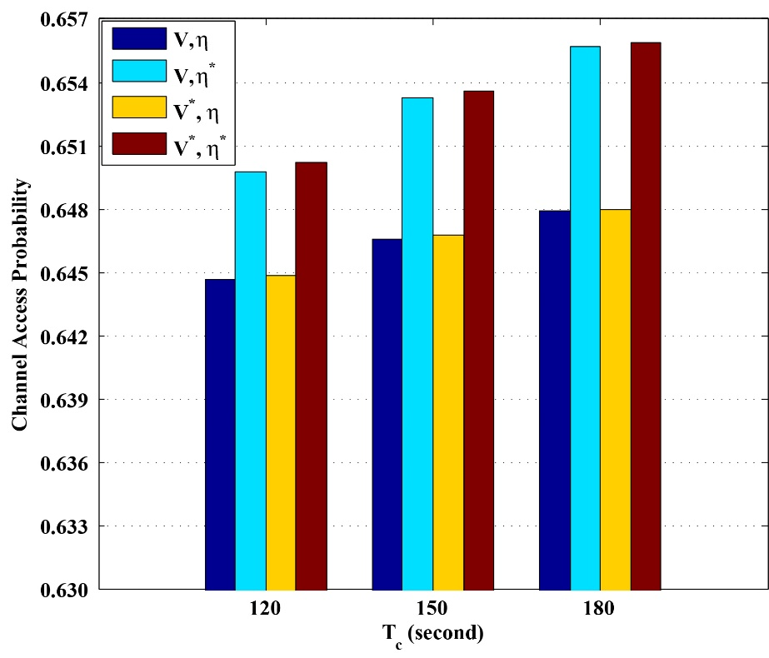
Simulation analysis
Channel access probability under different optimization conditions
19
Notes:
We found that the energy consumption under the optimized algorithm is more energy-efficient than the optimized algorithm in this picture , the optimized algorithm improves the endurance of the UAV when the distance between the UAV and the cluster head vehicle is increased. And the threshold value of receive power set by the vehicle is not changed, the energy consumption is also increased as the altitude is increased. We further found that this effect is greater with increasing.
altitude

Slide 20
Conclusions
First, channel access probability can be improved by adopting a dynamic channel schedule and optimizing the UAV speed of each subregion.
Second, compared with constant UAV speed or channel schedule, the simulation results reveal that the proposed method performances well in channel access probability and achievable rate.
20

Slide 21
Future work
In future research, we will pay more attention to the cooperative flight of multiple UAVs, including the research of FANET's communication routing protocol, the collaborative trajectory of multiple drones and energy optimization.
In future research, we will perform field simulations in various scenarios.

Slide 22
Thank you!
College of Information Science and Technology
Donahue University, Shanghai, China

